Slide 1
Summarizing Software Artifacts: A Case Study of Bug Reports
Published By: Sarah Rastkar, Gail C. Murphy and Gabriel Murray Department of Computer Science, University of British Columbia
Presented in icse 2010
Presented by: rajat SArin

Slide 2
introduction
Any successful software system requires the creation and management of many artifacts.
To work on a system, a software developer must often read and understand artifacts associated with the system development.
For example, a developer attempting to ﬁx a performance bug on a system may be told that a similar bug was solved six months ago.

Slide 3
Introduction continued..
One way to reduce the time a developer spends getting to the right artifacts to perform their work is to provide a summary of each artifact.
Alternatively, generate summaries of project artifacts, saving developers eﬀort and enabling up-to-date summaries on-demand.
In this paper, the authors tried to investigate the possibility of automatic summary generation, focusing on one kind of project artifact, bug reports.

Slide 4
Approach towards the goal
To enable this investigation, the authors recruited 10 human annotators to create summaries for 36 bug reports, creating a corpus of bug report data.
They then applied existing classiﬁers trained on email, and email and meeting data to produce summaries for reports in the bug report corpus.
The authors also trained a classiﬁer speciﬁc to bug reports and applied it to the bug report corpus

Slide 5
Annotation process
The authors had each individual annotate a subset of bugs from four diﬀerent open-source software projects: Eclipse Platform, Gnome, Mozilla and KDE.
The 36 bugs reports (nine from each project) chosen for annotation have mostly conversational content.
Each annotator was assigned a set of bug reports from those chosen from the four systems and were asked to write an abstractive summary of the report with the help of BC3 web based annotation software.

Slide 6
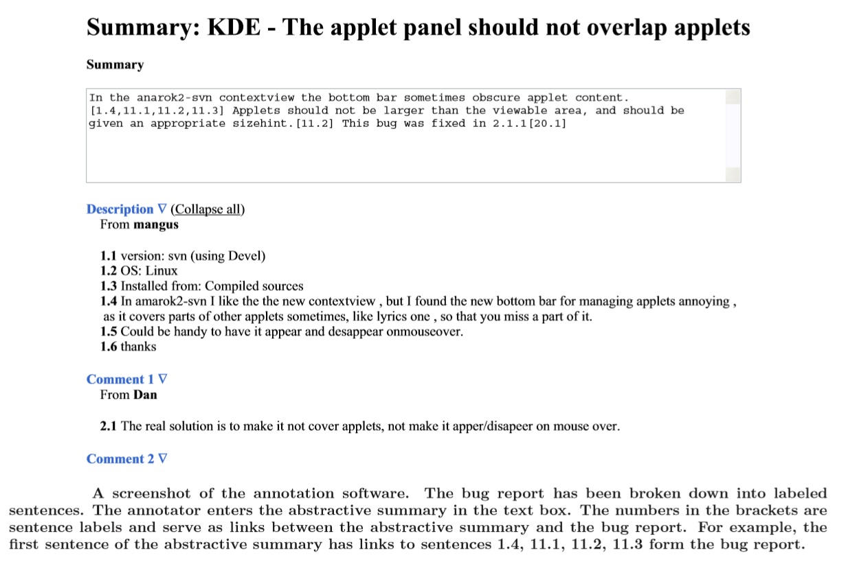

Slide 7
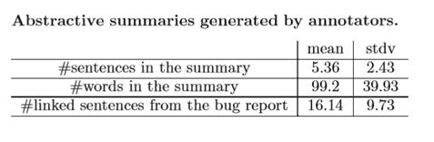
Annotated bugs
On average, the bug reports being summarized comprised 65 sentences and the abstractive summaries created by the annotators comprised just over ﬁve sentences with each sentence in the abstractive summaries linked to three sentences in the original bug report.

Slide 8
Annotated bugs continued
A common problem of annotation is that annotators often do not agree on the same summary.
To mitigate this problem, three annotators were assigned to each bug report.
The authors then used the kappa test to measure the level of agreement between the annotators which displayed a moderate level of agreement.

Slide 9
Annotated bugs continued
At the end of annotating each bug report, the annotator was asked to complete a questionnaire about properties of the report.
The level of diﬃculty of summarizing the bug report
The amount of irrelevant and oﬀ-topic discussion in the bug report
The level of project-speciﬁc terminology used in the bug report

Slide 10
Research questions
Can we produce good summaries with existing conversation-based classiﬁers?
How much better can we do with a classiﬁer speciﬁcally trained on bug reports?

Slide 11
Classifier 1
The ﬁrst classiﬁer, referred to as EC, was trained on email threads.
This classiﬁer was chosen as bug report conversations share similarity with email threads, such as being multi-party and having thread items added at diﬀering intervals of time
This classiﬁer was trained on a subset of the publicly available Enron email corpus, which consists of 39 annotated email threads.

Slide 12
Classifier 2
The second classiﬁer, referred to as EMC, was trained on a combination of email threads and meetings.
This classiﬁer was chosen because some of the characteristics of bug reports might be more similar to meetings, such as having concluding comments at the end of the conversation.
The meetings part of the training set for EMC is a subset of the publicly available AMI meeting corpus.

Slide 13
Classifier 3
The authors also chose to train a third classiﬁer, BRC, using the bug report corpus they created.
To form the training set for BRC, they combined the three human annotations for each bug report by scoring each sentence of a report based on the number of times it has been linked by annotators.
A sentence is considered to be part of the extractive summary if it has a score of two or more and was a part of the gold standard summary.

Slide 14
Classifier 3 continued
Authors used a cross validation technique when evaluating this classiﬁer.
A leave-one-out procedure was used so that the classiﬁer used to create a summary for a particular bug report is trained on the remainder of the bug report corpus.

Slide 15
Conversation features
The classiﬁer framework used to implement EM, EMC and BRC can learn based on 24 diﬀerent features categorized into 4 major groups
Structural features, related to the conversational structure of the bug reports.
Participant features, related to the conversation participants.
Length features, which included the length of the sentence normalized by the length of the longest sentence in the comment as well as the longest sentence in the bug report.
Lexical features, related to the occurrence of unique words in the sentence.

Slide 16
evaluation
Authors used several measures that compare summaries generated by the three classiﬁers to the gold standard summaries formed from the human annotation of the bug report corpus.
These measures assess the quality of each classiﬁer and enable the comparison of eﬀectiveness of the diﬀerent classiﬁers against each other.
To check the performance of the classiﬁers from a human perspective, authors also reported an evaluation in which they asked human judges to evaluate the goodness of a set of generated summaries against the original bug reports.

Slide 17
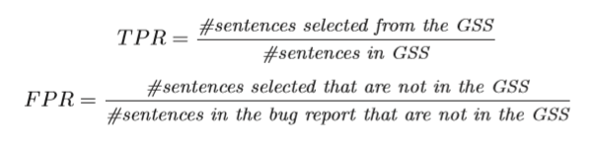
Comparing base effectiveness
The ﬁrst comparison considered was whether the three classiﬁers produced summaries that were better than a random classiﬁer in which a coin toss is used to decide which sentences to include in a summary.
This comparison was performed by plotting the receiver operator characteristic (ROC) curve and then computing the area under the curve.

Slide 18
Comparing classifiers
To investigate whether any of EC, EMC or BRC work better than the other two, the classifiers were compared using the standard evaluation measures of precision, recall, and F-score.
They also used pyramid precision, which is a normalized evaluation measure taking into account the multiple annotations available for each bug report.

Slide 19

Precision and recall
Precision measures how often a classiﬁer chooses a sentence from the gold standard summaries (GSS) and is computed as follows
Recall measures how many of the sentences present in a gold standard summary are actually chosen by the classiﬁer. For a bug report summary, the recall is the same as the TPR.

Slide 20
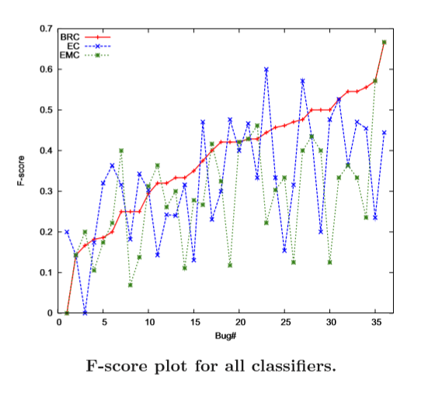

F-Score
As there is always a trade-oﬀ between precision and recall, the F-score is used as an overall measure.
The best F-score typically occurs with the BRC classiﬁer.

Slide 21
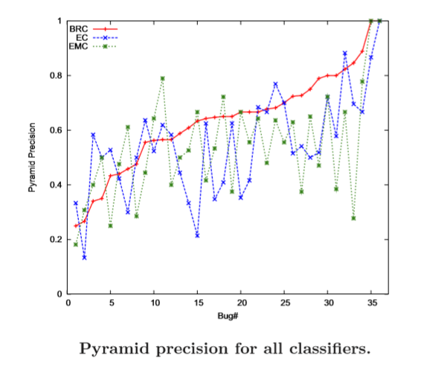
Pyramid precision
For each generated summary of a given length, we count the total number of times the sentences in the summary were linked by annotators. Pyramid precision is computed by dividing this number by the maximum possible total for that summary length
The ﬁgure shows that BRC has better precision values for most of the bug reports

Slide 22
summary
To investigate whether the BRC is signiﬁcantly better than the other two, the authors performed t-tests: one to see if the pyramid precision of BRC is signiﬁcantly better that that of EC, one to see if the pyramid precision of BRC is signiﬁcantly better that that of EMC, and so on.
The results conﬁrmed that the BRC out-performs the other two classiﬁers with statistical signiﬁcance while EC and EMC have similar performance.

Slide 23
Feature selection analysis
All of the three classiﬁers used in the study used a set of 24 features to generate summaries of bug reports and the values of these features for each sentence are used to compute the probability of the sentence being part of the summary.
For this analysis, we compute the F-score value for each of the 24 features.

Slide 24
F-score for Feature selection analysis
The score depends only on the set of features and the training data and is independent of the classiﬁer.
The results show that the length features were among the most helpful. Several lexical features were also helpful.
These results suggest that we may be able to train more eﬃcient classiﬁers by combining lexical and length features of the conversation.

Slide 25
Human evaluation
To investigate whether the summaries are of suﬃcient quality for human use, we set up an evaluation of the generated summaries of the BRC classiﬁer with a group of eight human judges.
Each summary was evaluated by three diﬀerent judges. The human judges were instructed to read the original bug report and the summary before starting the evaluation process.

Slide 26
Human evaluation continued
Each judge was asked to rank each bug report summary based on four statements:
The important points of the bug report are represented in the summary. (3.54 ± 1.10)
The summary avoids redundancy. (4.00 ± 1.25)
The summary does not contain unnecessary information. (3.91 ± 1.10)
The summary is coherent. (3.29 ± 1.16)

Slide 27
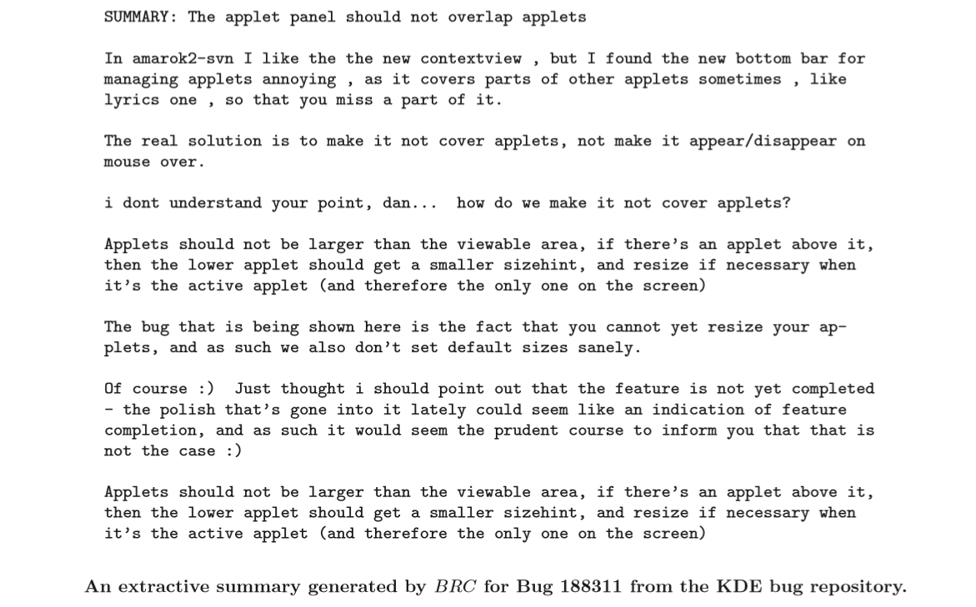

Slide 28
questions
What are the possible threats to this research?
How can one increase the accuracy of the bug report summarizer?

Slide 29


